Slide 1

THIS PROJECT HAS RECEIVED FINANCIAL SUPPORT FROM THE EUROPEAN SOCIAL FUND AND FROM GOVERNMENT OF THE CZECH REPUBLIC
Development of software for time-lapse microscopy
Dzmitry Lahoda
LEADER OF THE PROJECT: JAN URBAN
Bioengineering group of Dalibor Štys, 2009
Notes:
1

Slide 2
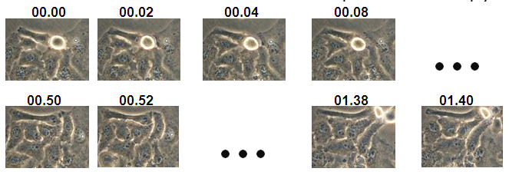
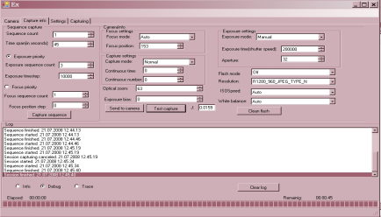
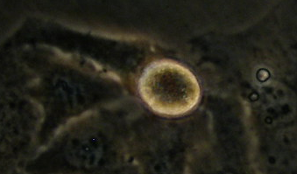
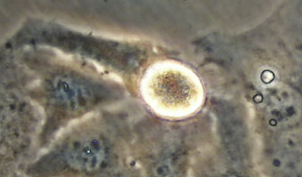
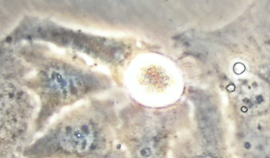
Last year work
developed application for time-lapse microscopy
which provided possibility to take photos using different setups
Schola Ludus 2008
2/13
Notes:
2

Slide 3
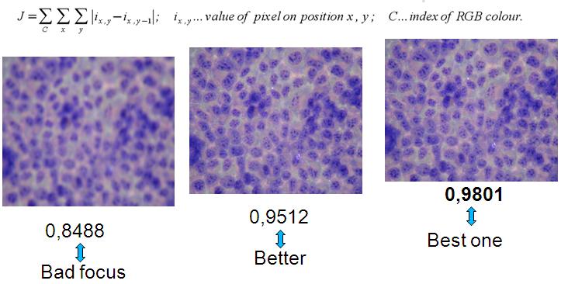
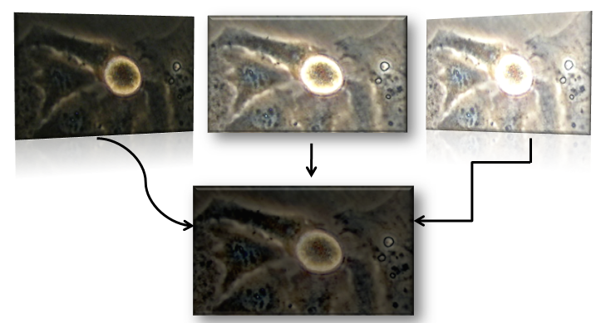
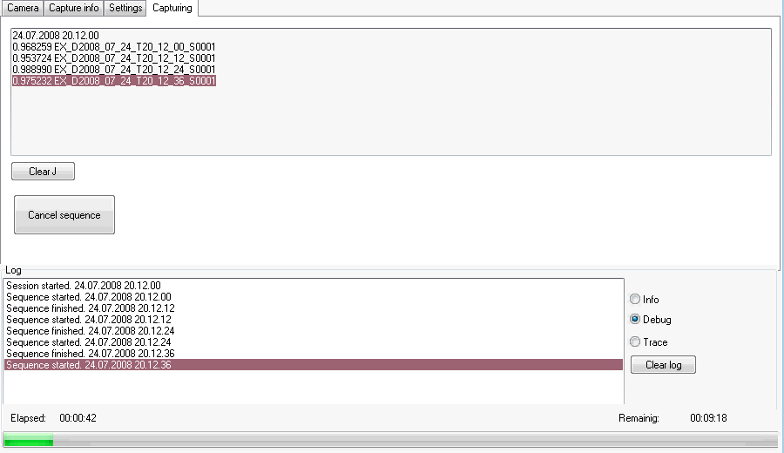
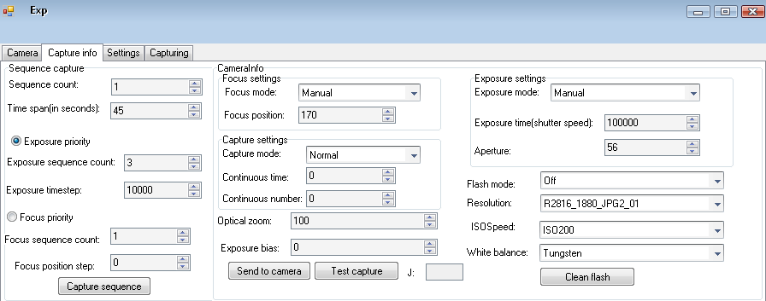

Last year work
Problem: low contrast pictures
Solution: new software for taking pictures with different setups
Problem: automatically controlled focus quality
Solution: contrast measurement algorithm
3/13

Slide 4
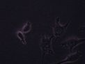
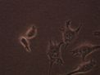
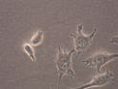
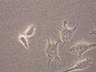
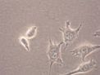
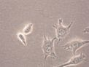
This year problems and tasks
1. How to choose setups to get maximum information and to support consistency of data between experiments?
2. Provide possibility to store all information on 32Gb flash in RAW format
RAW Raw image formats' purpose is to faithfully record both 100% of exactly what the sensor "saw" and the conditions surrounding the recording of the image. | JPEG,TIFF Lost and distortion of initial data.
4/13
Notes:
http://en.wikipedia.org/wiki/Raw_image_format
A raw image file contains minimally processed data from the image sensor of either a digital camera, image or motion picture film scanner. Raw files are so named because they are not yet processed and therefore are not ready to be used with a bitmap graphics editor or printed. Normally, the image is processed by a raw converter in a wide-gamut internal colorspace where precise adjustments can be made before conversion to a "positive" file format such as TIFF or JPEG for storage, printing, or further manipulation, which often encodes the image in a device-dependent colorspace. These images are often described as "RAW image files" based on the erroneous belief that they represent a single file format. In fact there are dozens if not hundreds of raw image formats in use by different models of digital equipment (like cameras or film scanners).[1]
Raw image files are sometimes called digital negatives, as they fulfill the same role as negatives in film photography: that is, the negative is not directly usable as an image, but has all of the information needed to create an image. Likewise, the process of converting a raw image file into a viewable format is sometimes called developing a raw image, by analogy with the film development process used to convert photographic film into viewable prints. The selection of the final choice of image rendering is part of the process of white balancing and color grading.
Like a photographic negative, a raw digital image may have a wider dynamic range or color gamut than the eventual final image format, and is usually the one "closest" to the real picture in the sense that it preserves most of its details. Raw image formats' purpose is to faithfully record both 100% of exactly what the sensor "saw" or "sensed" (the data), and the conditions surrounding the recording of the image (the metadata).

Slide 5
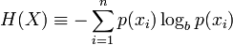
First problem decision
We have chosen Shannon Entropy as function for measure of information on picture and objective function for to get consistent data from experiments
3.2
5.5
5/13
Notes:
http://en.wikipedia.org/wiki/Entropy_(information_theory)

Slide 6
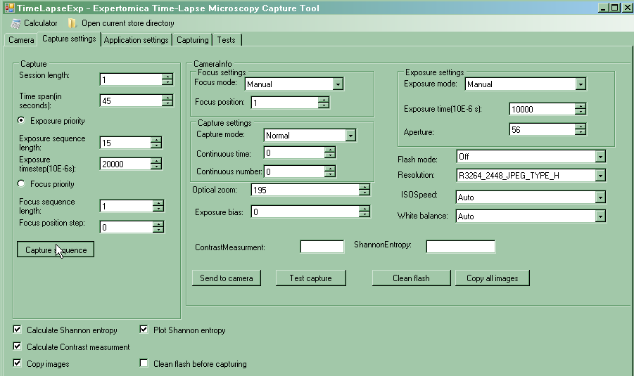
Software
Find best exposure time
1
2
0 Other setups
4
3
6/13

Slide 7
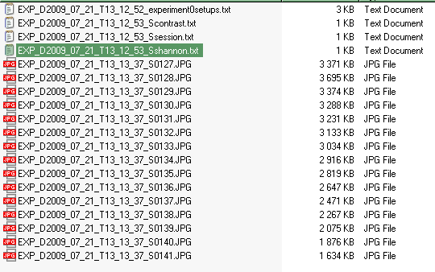
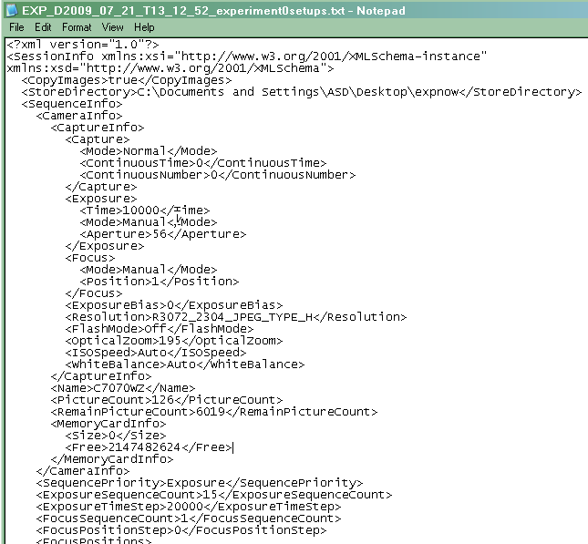
Software
Time-lapse experiment data
Data stored in folder
File describing camera setups
7/13

Slide 8
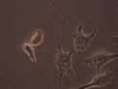
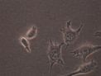
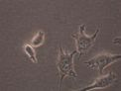
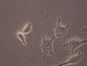
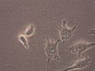
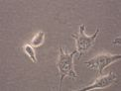
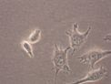
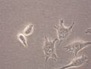
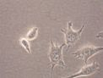
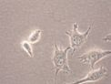
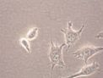
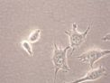
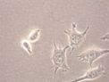
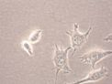
Exposure Time
8/13
Notes:
http://en.wikipedia.org/wiki/Shutter_speed
http://en.wikipedia.org/wiki/Exposure_(photography)
In photography, shutter speed is a common term used to discuss exposure time, the effective length of time a shutter is open;[1] the total exposure is proportional to this exposure time, or duration of light reaching the film or image sensor.

Slide 9
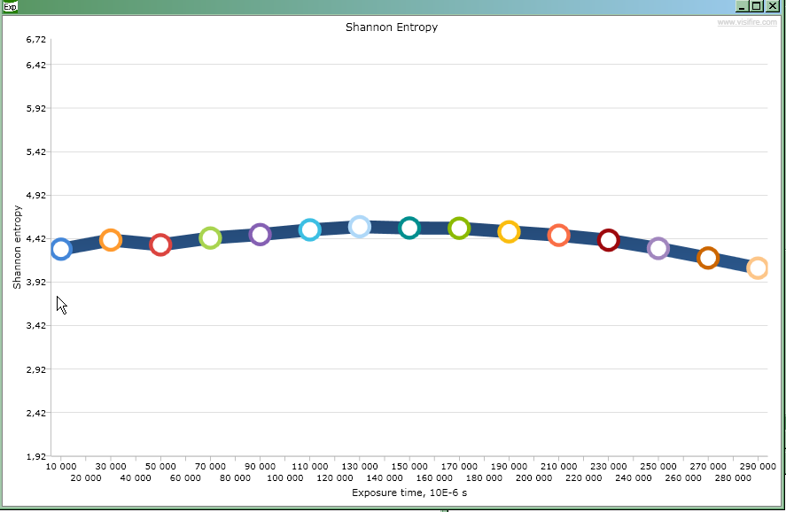
Software
Shannon Entropy and Exposure Time
Choose 3 exposure times near best Shannon entropy
9/13

Slide 10
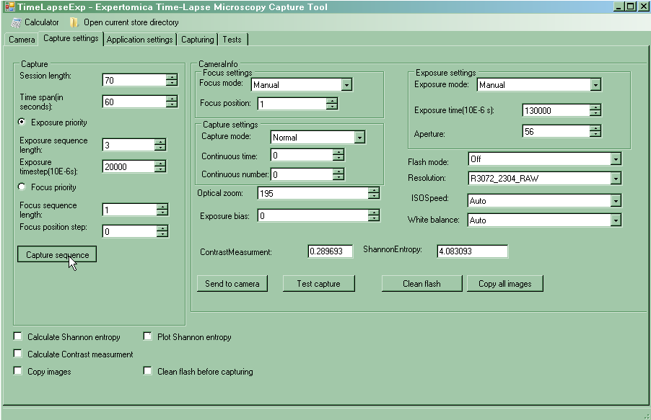
Software
Make long running experiment
4
2
3
1
0 Other setups
6
5
10/13

Slide 11
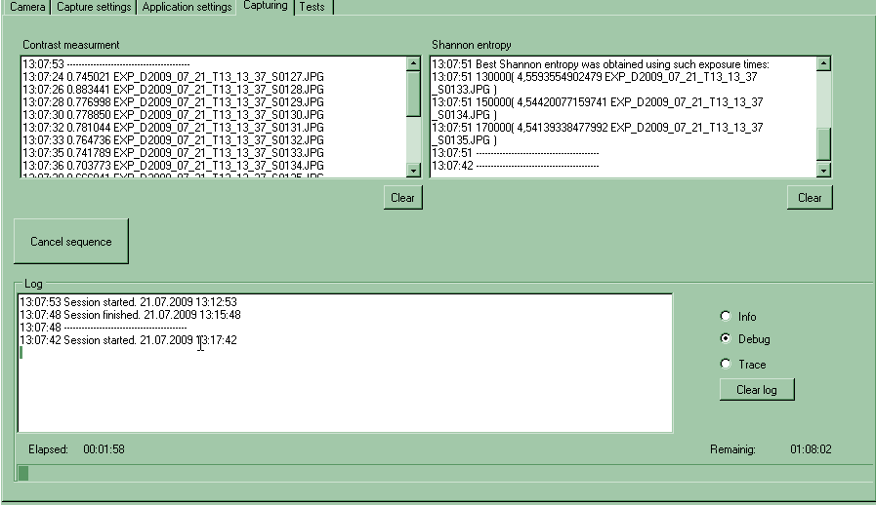



Software
Auditing
Workflow, timings, computed values
11/13

Slide 12
Conclusion
Problem: necessity in objective function for choosing exposure times and supporting experiments’ consistency
Solution: usage of Shannon entropy
Problem: store RAW images on flash
Solution: enabled, but
because of limitation in collaboration of Olympus C7070WZ with 32Gb flash and SDK normal capturing appears only up to 8GB
TimeLapseExp - Time-Lapse Microscopy Capture Tool
12/13

Slide 13
Thank you for attention
Development of software for time-lapse microscopy
Download: http://timelapseexp.codeplex.com
Usage video: http://www.youtube.com/watch?v=064aGvEAdJQ

Slide 14
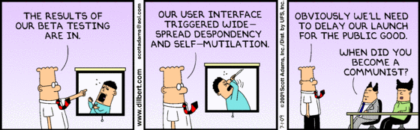

Slide 15
Appendix A. Possible ways from RAW to .NET image
wrapper-converter
dcraw
Camera RAW
(e.g. Olympus ORF)
Windows Imaging Component
wrapper-converter
.NET
wrapper-converter
RAW2DNG converter

